Slide 1


Slide 2
What is an Operating System?
A system software .
An operating system is a resource allocator.
An Operating System controls (manages) hardware and software.
provides support for peripherals such as keyboard, mouse, screen, disk drives, …
software applications use the OS to communicate with peripherals.
The OS typically manages (starts, stops, pauses, etc) applications.
-

Slide 3
UNIX/LINUX
What is UNIX?
The UNIX is a multiuser, multitasking operating system.
operating system was originally developed at Bell Laboratories, in the 1970's, for the Digital Equipment PDP computers.
What is Linux?
Linux is a freely distributed implementation of a UNIX-like kernel.

Slide 4
Overview of the LINUX
Linux is multitasking, multiuser operating system.
Created in the 1990s by Linus Torvalds
Linux is inspired by the UNIX operating system which first appeared in 1969-70, in AT & T Bell Labs.
conventions behind UNIX also exist in Linux and are central to understanding the basics of the system.

Slide 5
Versions
Examples of Linux Operating Systems, called “distributions”:
Ubuntu
Debian
Fedora
Redhat
CentOS
SuSE

Slide 6
Features of Linux
Multi-tasking operating system
Multiuser operating system
Linux is free
Linux is portable to any hardware platform
Linux is secure and versatile:
Linux is scalable:

Slide 7
Responsibilities of LINUX
The Linux Operating System is responsible for the following functions
Process management using processes and threads
Inter-process communication
Memory management
Device management using device drivers
File systems

Slide 8
The Linux subsystem
User Applications
The set of applications in use on a particular Linux system will be different depending on what the computer system is used for, but typical examples include a word-processing application and a web-browser
O/S Services
These are services that are typically considered part of the operating system (a windowing system, command shell, etc.); also, the programming interface to the kernel (compiler tool and library) is included in this subsystem
Linux Kernel
Kernel is the heart of the operating system. The kernel of Linux is the hub of the operating system. It is loaded into memory when the system is booted and communicates

Slide 9
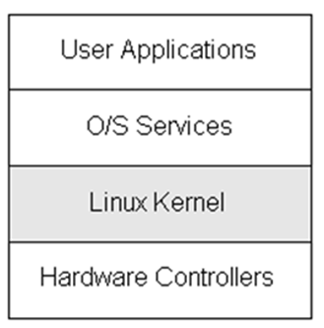
The LINUX Subsystem

Slide 10
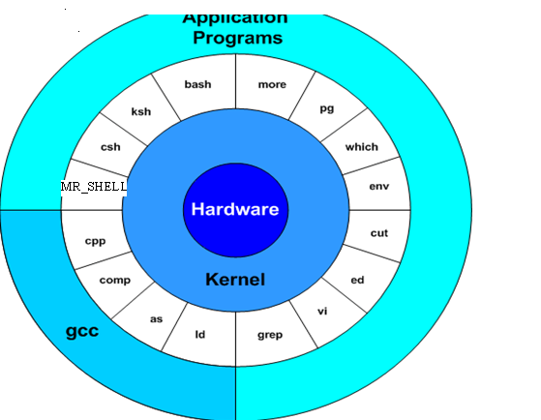
Architecture of Linux
Kernel schedules tasks.
Manages data/file access and storage.
Enforces security mechanisms.
Performs all hardware access.
memory and processor management
sharing the processor among multiple programs

Slide 11
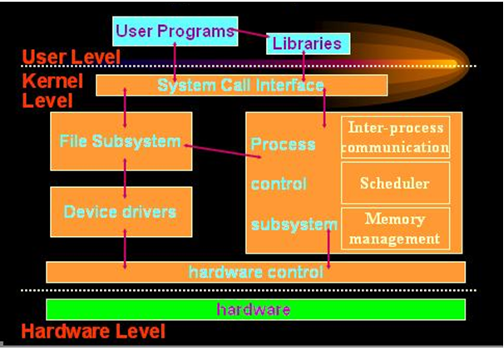
Block Diagram of Kernel

Slide 12
The shell
The shell acts as an interface between the user and the kernel.
The shell is a command line interpreter (CLI).
It interprets the commands the user types in and arranges for them to be carried out.
The main functions of the shell are:
Presents each user with a prompt.
Interprets commands types by a user.
Executes user commands.
Supports a custom environment for each user.
It enables users to run application programs

Slide 13
Shell Offerings
The most common ones are sh, csh, tcsh, ksh, bash, and zsh.
Sh is the bourne shell. Which is the defaul tshell
Ksh is very similar in syntax and features as bash however ksh is not free while bash is free. Bash is licensed under the Free Software Foundation.
csh and tcsh are both based on the c language and makes writing shell scripts easier if you know the language. Both have similar features with tcsh having a few more.
Zsh is the Z shell. It most closely resembles ksh

Slide 14
Features of LINUX SHELL
Command line interpretation
Establishes user environment
File History generation:
Input/output redirection
Pipeline connections
Programming language:
Job control:

Slide 15
LINUX VS WINDOWS

Slide 16
Financial Differences
Technical Differences
End-User Differences

Slide 17
The File system
A file system is a logical collection of files on a partition or disk. A partition is a container for information and can span an entire hard drive if desired.
Your hard drive can have various partitions which usually contains only one file system, such as one file system housing the / file system or another containing the /home file system.
One file system per partition allows for the logical maintenance and management of differing file systems.
Everything in Unix is considered to be a file, including physical devices such as DVD-ROMs, USB devices, floppy drives, and so forth.

Slide 18
Unix Directory Structure
Unix uses a hierarchical file system structure, much like an upside-down tree, with root (/) at the base of the file system and all other directories spreading from there.
A UNIX filesystem is a collection of files and directories that has the following properties:
It has a root directory (/) that contains other files and directories.
Each file or directory is uniquely identified by its name, the directory in which it resides, and a unique identifier, typically called an inode.
By convention, the root directory has an inode number of 2 and the lost+found directory has an inode number of 3. Inode numbers 0 and 1 are not used. File inode numbers can be seen by specifying the -i option to ls command.
It is self contained. There are no dependencies between one filesystem and any other.
The directories have specific purposes and generally hold the same types of information for easily locating files. Following are the directories that exist on the major versions of Unix:

Slide 19
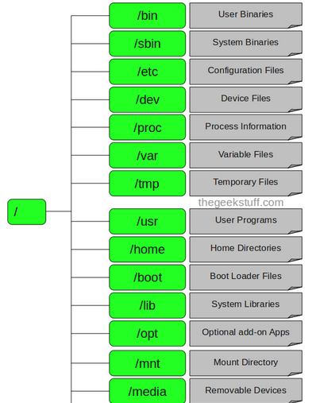
The LINUX File System

Slide 20
The Root Directory
< / > Root
The root directory. The starting point of your directory structure. This is where the Linux system begins. Every other file and directory on your system is under the root directory. Usually the root directory contains only subdirectories, so it's a bad idea to store single files directly under root.
Every single file and directory starts from the root directory.
Only root user has write privilege under this directory.
Don't confuse the root directory with the root user account, root password (which obviously is the root user's password) or root user's home directory.

Slide 21
BIN Directory
/bin – User Binaries
Contains binary executables.
Common linux commands you need to use in single-user modes are located under this directory.
Commands used by all the users of the system are located here.
For example: ps, ls, ping, grep, cp.
/sbin – System Binaries
Just like /bin, /sbin also contains binary executables.
But, the linux commands located under this directory are used typically by system aministrator, for system maintenance purpose.
For example: iptables, reboot, fdisk, ifconfig, swapon

Slide 22
/etc
< /etc >
The configuration files for the Linux system. Most of these files are text files and can be edited by hand. Some interesting stuff in this directory:
/etc/inittab A text file that describes what processes are started at system bootup and during normal operation. For example, here you can determine if you want the X Window System to start automatically at bootup, and configure what happens when a user presses Ctrl+Alt+Del
/etc/fstab This file contains descriptive information about the various file systems and their mount points, like floppies, cdroms, and so on.
/etc/passwd A file that contains various pieces of information for each user account. This is where the users are defined.

Slide 23
/user
< /usr >
This directory contains user applications and a variety of other things for them, like their source codes, and pictures, docs, or config files they use. /usr is the largest directory on a Linux system, and some people like to have it on a separate partition. Some interesting stuff in /usr:
/usr/doc Documentation for the user apps, in many file formats.
/usr/share Config files and graphics for many user apps.
/usr/src Source code files for the system's software, including the Linux kernel.
/usr/include Header files for the C compiler. The header files define structures and constants that are needed for building most standard programs. A subdirectory under /usr/include contains headers for the C++ compiler.
< /usr/local >
This is where you install apps and other files for use on the local machine. If your machine is a part of a network, the /usr directory may physically be on another machine and can be shared by many networked Linux workstations. On this kind of a network, the /usr/local directory contains only stuff that is not supposed to be used on many machines and is intended for use at the local machine only.

Slide 24
/dev & /proc
/dev – Device Files
Contains device files.
These include terminal devices, usb, or any device attached to the system.
For example: /dev/tty1, /dev/usbmon0
/proc – Process Information
Contains information about system process.
This is a pseudo filesystem contains information about running process. For example: /proc/{pid} directory contains information about the process with that particular pid.
This is a virtual filesystem with text information about system resources. For example: /proc/uptime

Slide 25
/var & /tmp
/var – Variable Files
var stands for variable files.
Content of the files that are expected to grow can be found under this directory.
This includes — system log files (/var/log); packages and database files (/var/lib); emails (/var/mail); print queues (/var/spool); lock files (/var/lock); temp files needed across reboots (/var/tmp);
/tmp – Temporary Files
Directory that contains temporary files created by system and users.
Files under this directory are deleted when system is rebooted

Slide 26
/lib – System Libraries
Contains library files that supports the binaries located under /bin and /sbin
Library filenames are either ld* or lib*.so.*
For example: ld-2.11.1.so, libncurses.so.5.7
/opt – Optional add-on Applications
opt stands for optional.
Contains add-on applications from individual vendors.
add-on applications should be installed under either /opt/ or /opt/ sub-directory.
/mnt – Mount Directory
Temporary mount directory where sysadmins can mount filesystems.
/media – Removable Media Devices
Temporary mount directory for removable devices.
For examples, /media/cdrom for CD-ROM; /media/floppy for floppy drives; /media/cdrecorder for CD writer
/srv – Service Data
srv stands for service.
Contains server specific services related data.
For example, /srv/cvs contains CVS related data.

Slide 27
LINUX COMMANDS

Slide 28
Type command
To check a command is internal or external
Internal commands are the built in commands of the shell. Which means that when you execute an internal command, no process will be launched to execute the command. Therefore the speed of executing an internal command will be very high. Example – cd,pwd,echotc. External commands are those command which are stored as a separate binaries. Shell starts separate sub-process to execute them. Most external commands are stored in the form of binaries in /bin directory. To execute external command shell check $PATH variable . If command present in the location mentioned in $PATH variable shell will execute it , otherwise it will give error. example – ls,mv,cat etc.

Slide 29
Uname
The Uname command lists the name of the current system you are logged into
Uname –s gives the os name
Uname –r gives the version of os
Uname –x gives the detail

Slide 30
man
Man ual command. man man This is help command, and will explains you about online manual pages you can also use man in conjunction with any command to learn more about that command for example.
man ls will explain about the ls command and how you can use it.
man -k pattern command will search for the pattern in given command.

Slide 31
pwd
Pwd command. pwd command will print your home directory on screen, pwd means present working directory.

Slide 32
calendar
Calendar command calendar command reads your calendar file and displays only lines with current day. For example in your calendar file if you have this
12/20 Test new software.
1/15 Test newly developed 3270 product.
1/20 Install memory on HP 9000 machine.
On dec 20th the first line will be displayed. you can use this command with your crontab file or in your login files.

Slide 33
clear
Clear command
clear command clears the screen and puts cursor at beginning of first line.

Slide 34
Tty
Tty command Tty command will display your terminal. Syntax is tty options
Options
-l will print the synchronous line number.
-s will return only the codes: 0 (a terminal), 1 (not a terminal), 2 (invalid options) (good for scripts)

Slide 35
File management commands
In UNIX there are three basic types of files:
Ordinary Files: An ordinary file is a file on the system that contains data, text, or program instructions. In this tutorial, you look at working with ordinary files.
Directories: Directories store both special and ordinary files. For users familiar with Windows or Mac OS, UNIX directories are equivalent to folders.
Special Files: Some special files provide access to hardware such as hard drives, CD-ROM drives, modems, and Ethernet adapters. Other special files are similar to aliases or shortcuts and enable you to access a single file using different names.

Slide 36
File Management
cat
cd
Cp
file
Head
Tail
ln
Ls
mkdir
More
Mv
pwd
Rcp
Rm
rmdir
wc.

Slide 37
ls
Ls command ls command is most widely used command and it displays the contents of directory.
options
ls will list all the files in your home directory, this command has many options.
ls -l will list all the file names, permissions, group, etc in long format.
ls -a will list all the files including hidden files that start with . .
ls -lt will list all files names based on the time of creation, newer files bring first.
ls -Fxwill list files and directory names will be followed by slash.
ls -Rwill lists all the files and files in the all the directories, recursively.
ls -R | more will list all the files and files in all the directories, one page at a time.

Slide 38
Mkdir/cd
Mkdir command.
mkdir cdac
This will create new directory, i.e. here cdac directory is created.
Cd command. cd cdac
This will change directory from current directory to cdac directory. Use pwd to check your current directory and ls to see if cdac directory is there or not.

Slide 39
cat
Cat command cat cal.txt cat command displays the contents of a file here cal.txt on screen (or standard out).

Slide 40
Creating a file
CAT command is used to create a file
Example
$ Cat > file name
Enter your text
Press ctrl+d, then the contents will be saved to that file
To see the contents of that file
$ cat filename
To append some text to that existing file
$ cat >> file name
Enter text you want to enter
Press ctrl+d ,then the text will be appended to that file

Slide 41
Concatenate two files
You can concatenate two file in to another file
$ Cat file1 file2 > file 3
Here the contents of file 1 and file2 will be concatented and the contents will be saved in file3
You can append the contents of one file or two file into another file
$ cat file1>> file2
$cat file1 file2 >> file3

Slide 42
Head/tail
Head command. head filename by default will display the first 10 lines of a file. If you want first 50 lines you can use head -50 filename or for 37 lines head -37 filename and so forth.
Tail command. tail filename by default will display the last 10 lines of a file. If you want last 50 lines then you can use tail -50 filename.

Slide 43
more
More command. more command will display a page at a time and then wait for input which is spacebar. For example if you have a file which is 500 lines and you want to read it all. So you can use
more filename

Slide 44
wc
Wc command wc command counts the characters, words or lines in a file depending upon the option.
Options
wc -l filename will print total number of lines in a file.
wc -w filename will print total number of words in a file.
wc -c filename will print total number of characters in a file.

Slide 45
cp
Cp command.
cp command copies a file. If I want to copy a file named oldfile in a current directory to a file named newfile in a current directory.
cp oldfile newfile
If I want to copy oldfile to other directory for example /tmp then cp oldfile /tmp/newfile.
Useful options available with cp are -p and -r . -p options preserves the modification time and permissions, -r recursively copy a directory and its files, duplicating the tree structure.

Slide 46
rcp
Rcp command. rcp command will copy files between two unix systems and works just like cp command (-p and -i options too). For example you are on a unix system that is called Cheetah and want to copy a file which is in current directory to a system that is called lion in /usr/john/ directory then you can use rcp command rcp filename lion:/usr/john You will also need permissions between the two machines. For more infor type man rcp at command line.

Slide 47
mv
Mv command. mv command is used to move a file from one directory to another directory or to rename a file.
Some examples:
mv oldfile newfile will rename oldfile to newfile.
mv -i oldfile newfile with confirmation prompt.
mv -f oldfile newfile will force the rename even if target file exists.
mv * destination dir will move all the files in current directory to destination directory.

Slide 48
rm
Rm command. To delete files use rm command.
Options:
rm oldfile will delete file named oldfile.
rm -f option will remove write-protected files without prompting.
rm -r option will delete the entire directory as well as all the subdirectories, very dangerous command.

Slide 49
rmdir
Rmdir command. rmdir command will remove directory or directories
Options:
rm -r directory_name will remove all files even if directory is not empty.
rmdir sandeep is how you use it to remove sandeep directory.
rmdir -p will remove directories and any parent directories that are empty.
rmdir -s will suppress standard error messages caused by -p.

Slide 50
Creating a file
CAT command is used to create a file
Example
$ Cat > file name
Enter your text
Press ctrl+d, then the contents will be saved to that file
To see the contents of that file
$ cat filename
To append some text to that existing file
$ cat >> file name
Enter text you want to enter
Press ctrl+d ,then the text will be appended to that file

Slide 51
Concatenate two files
You can concatenate two file in to another file
$ Cat file1 file2 > file 3
Here the contents of file 1 and file2 will be concatented and the contents will be saved in file3
You can append the contents of one file or two file into another file
$ cat file1>> file2
$cat file1 file2 >> file3

Slide 52
Question 1
The commonly used UNIX commands like date, ls, cat, etc. are stored in
/dev directory
/bin and /usr/bin directories
/tmp directory
/unix directory

Slide 53
Answer 1
/bin and /usr/bin directories

Slide 54
Q2
The seventh field of /etc/password is
password
login
shell
home

Slide 55
A2
shell

Slide 56
Q3
Which command is used to display the device name of the terminal you are using?
A. who
B. ls
C. tty
D. stty
E. None of the above

Slide 57
A3
. tty

Slide 58
Q4
Which command is used to set terminal IO characteristic?
tty
ctty
ptty
stty

Slide 59
A4
stty

Slide 60
Q5
Which command is used to change directory to the file beginning with a 'p'?
A. cd p
B. cd p?
C. cd p*
D. cd [p]
E. None of the above

Slide 61
A5
cd p*

Slide 62
Q6
. Write the command to display the current date in the form dd/mm/yyyy.
date +%d/%m/%Y
date +”%d/%m/%Y”
date +/%d/%m/20%y
date +”/%d/%m/20%y”

Slide 63
A6
date +%d/%m/%Y

Slide 64
Q7
Which command is used to print a file?
A. print
B. prn
C. pg
D. lp
E. None of the above

Slide 65
A7
lp

Slide 66
Q8
Which of the following commands is used to get directory one level up?
A. cd
B. cd ..
C. cd/
D. chdir
E. None of the above

Slide 67
A8
cd ..

Slide 68
Q9
Which command is used to delete all files in the current directory as well as all files and sub-directories in its subdirectories?
A. rm *
B. rm -r *
C. rm all
D. rm *.*
E. None of the above

Slide 69
A9
rm -r *

Slide 70
Q10
Which of the following commands is used to change the working directory?
A. cd
B. changedir
C. chdir
D. cdir
E. None of the above

Slide 71
A10
cd

Slide 72
Q11
Which of the following commands is used to view your file 24 lines at a time?
A. pg
B. cat
C. lp
D. /p
E. None of the above

Slide 73
A11
A. pg

Slide 74
Q12
) Which command is used to display the end of the file?
A. head - r
B. tail
C. eof
D. bof
E. None of the above

Slide 75
A12
tail

Slide 76
Q13
Which command is used to locate all the .profile files in the system?
A. ls profile
B. find /-name profile -print
C. cd /.profile
D. l -u .profile
E. None of the above

Slide 77
A13
B. find /-name profile -print

Slide 78
Q14
Which command is used to move all files to the bin sub-directory of the parent directory?
A. mv *.* /bin/
B. mv * /bin/*
C. mv * ../bin
D. mv * ../bin *.*
E. None of the above

Slide 79
A14
. mv * ../bin

Slide 80
Q15
The command used to remove the directory is;
A. rmdir
B. rd
C. remove
D. rdir
E. None of the above

Slide 81
A15
rmdir

Slide 82
Q16
Which of the following commands is used to remove files?
A. erase
B. delete
C. rm
D. dm
E. . None of the above

Slide 83
A16
rm

